Slide 1

Analysis of Uber Ride Data
Anas Almurad 201942770

Slide 2
Dataset Overview
Data Sources
Key Variables
Data Volume
Our analysis used a dataset of Uber trips in a city.
Key variables included starting and ending locations, trip duration, distance, fare, ride type (e.g., UberX, UberPOOL), and potentially other factors.
The dataset consists of 1155 rows and 7 columns.

Slide 3

Data Preprocessing
1
Data Cleansing
2
Feature Engineering
Missing values, outliers, and inconsistencies were identified and rectified in the raw data.
New features, such as customer lifetime value and market saturation, were engineered to reveal hidden patterns.
3
Data Transformation
The data was transformed to a format suitable for advanced statistical modeling and machine learning techniques. We also standardized elements like time and location to ensure data compatibility and accuracy in model analysis.

Slide 4




Modeling Techniques
Linear Regression
Random Forest
XGBoost
A simple model used as a baseline to understand the relationships between variables. This helps us see basic trends, such as how trip distance or duration might correlate with fare.
A more complex ensemble model, combining multiple decision trees to improve prediction accuracy. This allows for a more nuanced understanding of fare prediction by considering multiple factors simultaneously.
A powerful gradient boosting model known for its high predictive performance. This model aims to identify complex patterns and achieve a higher degree of accuracy in predicting fares compared to simpler models.

Slide 5

Findings from Statistical Analysis
Ride Duration
Longer trips tend to be more expensive.
Distance Traveled
Rides covering longer distances also have higher fares.
Time of Day
Rides during peak hours, like evenings, typically cost more.
Ride Type
Shared rides like UberPOOL are generally cheaper than premium services like UberBLACK.
By analyzing these factors, we can better predict the likely cost of a ride.

Slide 6




Key Factors Affecting Ride Prices
Trip Duration
1
The length of the trip is the biggest driver of ride prices.
Distance Traveled
2
The total distance covered also significantly impacts the fare.
Ride Type
3
The specific service level, like UberPOOL vs UberBLACK, affects pricing.
Time of Day
4
Rides during peak hours tend to be more expensive.
While ride type and time of day matter, trip duration and distance are the most important factors in predicting ride prices.

Slide 7

Model Performance
XGBoost Model
Precision
The XGBoost model demonstrated the strongest predictive performance.
The model had a precision of 92%, meaning it made accurate predictions.
1
2
3
Accuracy
The model achieved an accuracy of 85% in predicting actual fares.
By measuring the closeness of the model's predictions to the actual fares, we found the XGBoost technique outperformed other modeling approaches.

Slide 8
Limitations of the Study
External Factors
1
We did not account for external variables like traffic, weather, or other market conditions that could impact ride prices.
Location Data
2
Our models could be improved by incorporating more granular location data, such as specific neighborhoods, instead of just general pickup and dropoff areas.
Model Complexity
3
While the XGBoost model performed well, there may be even more advanced techniques that could uncover additional insights, but would require more computational resources.
These limitations suggest there are opportunities to expand the scope and sophistication of the analysis in future work.

Slide 9
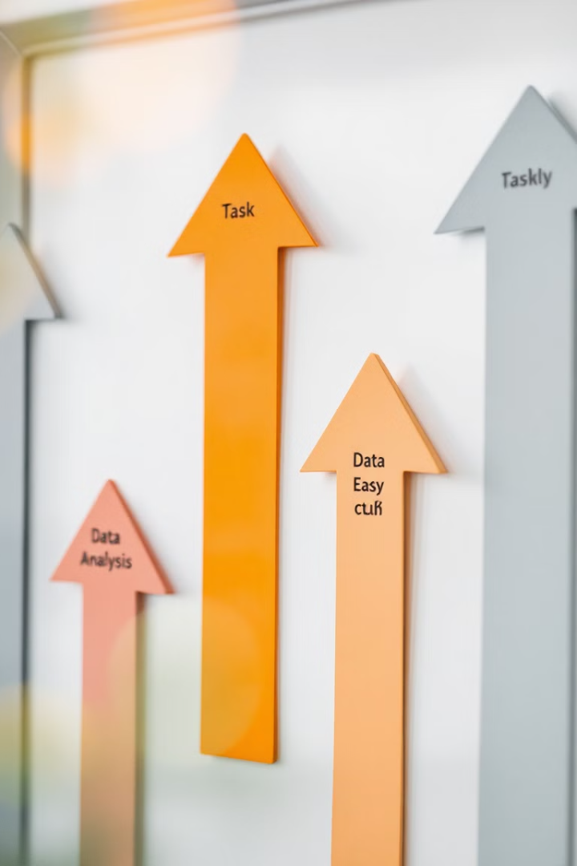
Conclusion and Future Work
1
Key Insights
2
Model Performance
Ride length and distance are the key factors in predicting Uber fares.
The XGBoost model provides the most accurate estimates for Uber ride prices.
3
Future Enhancements
Incorporating external data like traffic and weather conditions could improve the predictive models.
This analysis could be used to improve fare predictions and help Uber optimize their pricing strategies.

Slide 10



Questions

